Slide 1


Predictive
Maintenance

Slide 2

Predictive Maintenance
IOT on High Voltage
Sensor Data
Vibration vs Acceleration
FFT Analysis
Vibration Velocity Faults and Acceleration Faults
Variety of Sensors & Combinations
Why Predictive Maintenance
Energy & Quality of Input

Slide 3

IOT on High Voltage
Gather multiple Data Points from IOT Infrastructure to process through a preset algorithm to identify and predict asset failure.
A robust method is to implement multi sensor infrastructure which gives a dependable solution.

Slide 4
Sensor Data
Acceleration and Vibration Sensors
  To monitor vibrations to find mechanical failures
Oil Quality (PPM – Moisture Content)
  Oil contamination
Oil Level and Lubricant / Oil Flow Metrics
  Repeat replacements as per requirement
Electric Current & Voltage Harmonics
  Quality of electric supply
Pressure Sensor
  Early identification of pressure changes

Slide 5
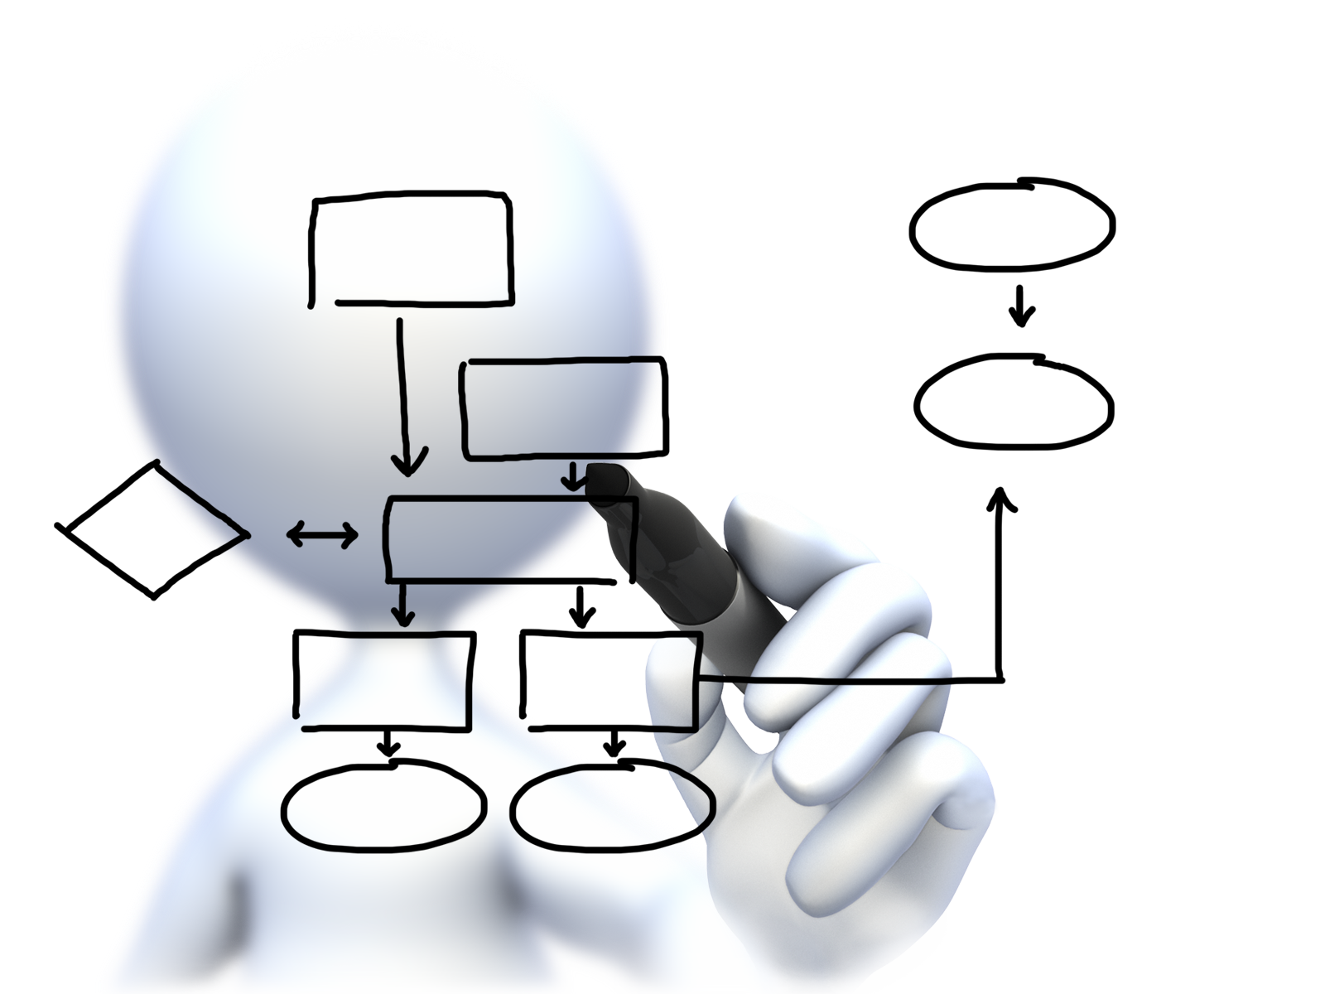
Vibration vs Acceleration
Vibration monitoring requires a sensor that can provide either Vibration Velocity or Vibration Acceleration
As per requirements, Vibration Acceleration can compute Vibration Velocity but not the other way round.
Acceleration monitoring requires a high frequency and high range sensor that can provide better specification of ‘g’ values.
Acceleration monitoring helps in conducting Spectrum Analysis also called as FFT (Fast Fourier Transform) Analysis.
With Acceleration sensors, time and frequency along-with FFT, H-FFT are generated.

Slide 6
FFT Analysis
A conclusive evidence for machine’s current health can be drawn from Acceleration sensors and Spectrum analysis.
Recommended practice is to capture as many data samples as possible.
FFT output delivers probability assessment of mechanical failures of the asset such as Looseness, Misalignment, Bearing Damage, Cavitation and more.
Recommended practice includes monitoring RPM of the asset so that accurate reasoning can be generated as asset performance can vary with damage and RPM both.

Slide 7
Vibration Velocity & Acceleration Faults
Velocity faults include physical structural challenges like looseness and misalignment.
Acceleration faults include integral challenges like bearing and balls inside bearing, cavitation related damages.

Slide 8
Type of sensors & Combinations
As vibration monitoring is useful for understanding physical structure, there are other variations to address machine’s health.
Even machine’s peripherals such as Oil, Electricity, Lubrication, Air should be monitored and actively compared with other parameters to identify dependencies on internal structure.
Motors and Pumps reveal more information about their activity if RPM is actively monitored in combination with other utility metrics.

Slide 9

Why Predictive Maintenance
With one-time CAPEX, a system can be rolled out that saves more on downtime costs. For example, in a sugar industry; if the initial motor breaks down, the downtime costs will be around 3 shifts resulting in wastages and monetary losses.
One-time investment in sensors and IOT infrastructure, allows maintenance teams to take shutdowns only when needed and the plant can have more active hours.

Slide 10
Energy & Quality of Input
As energy is the main fuel for any asset; quality of incoming energy is also important.
We must monitor how much energy is utilized by the asset and also the quality which is provided by the harmonic's information in real time.
Also, power factors and current spikes guide in effective maintenance of the asset.

Slide 11

Steps of Predictive Maintenance
Continuous monitoring of the assets helps in capturing datasets relevant to that asset’s life cycle and helps in assessing the asset better.
Additionally newer technologies such as AI / ML require a broad dataset reflecting not just faults but a proper working sample set as well.
Hence, Predictive Maintenance is not just about generating failure cases or predictions but also to assess what’s healthy and what’s not.

Slide 12

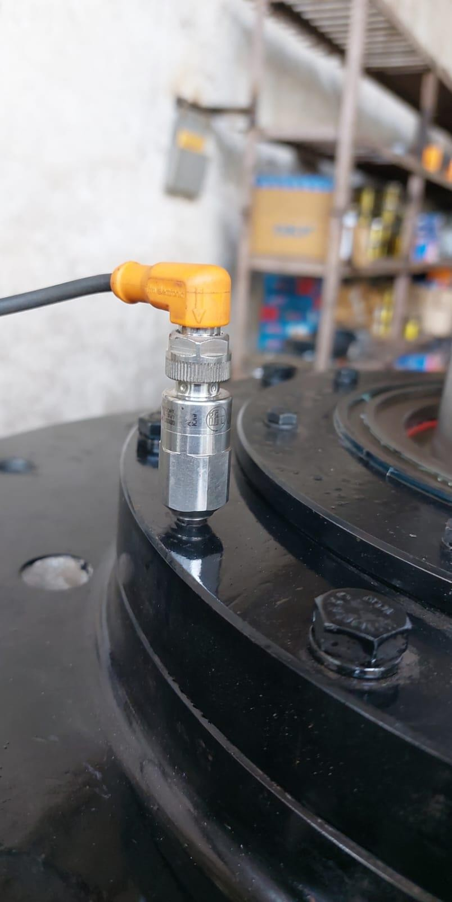
Implementation of Predictive Maintenance

Slide 13
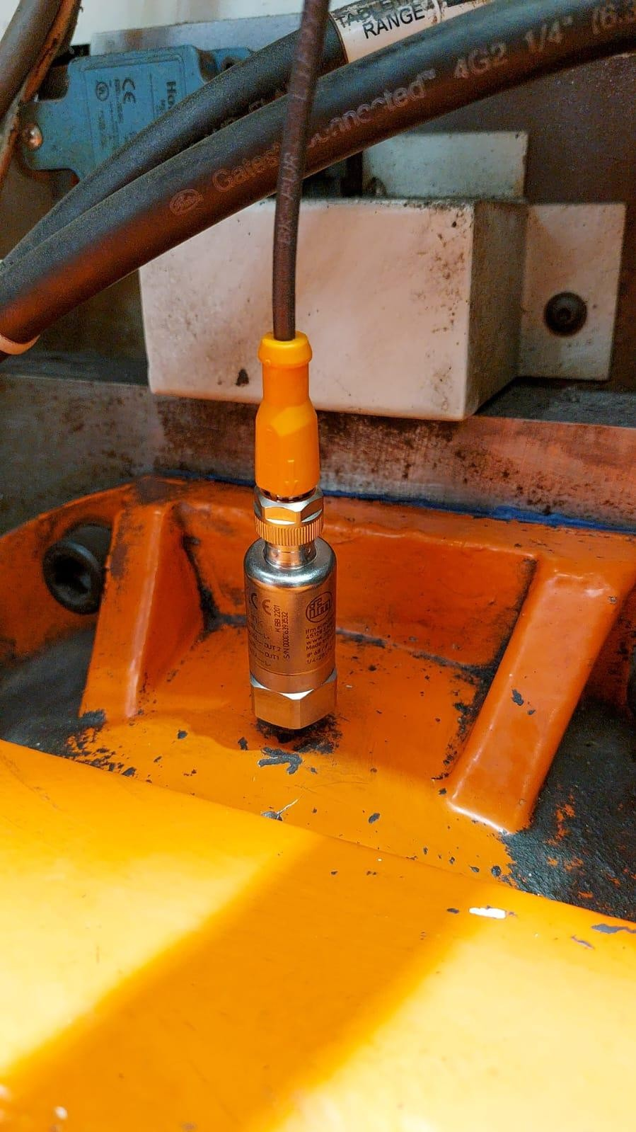
Implementation of Predictive Maintenance

Slide 14
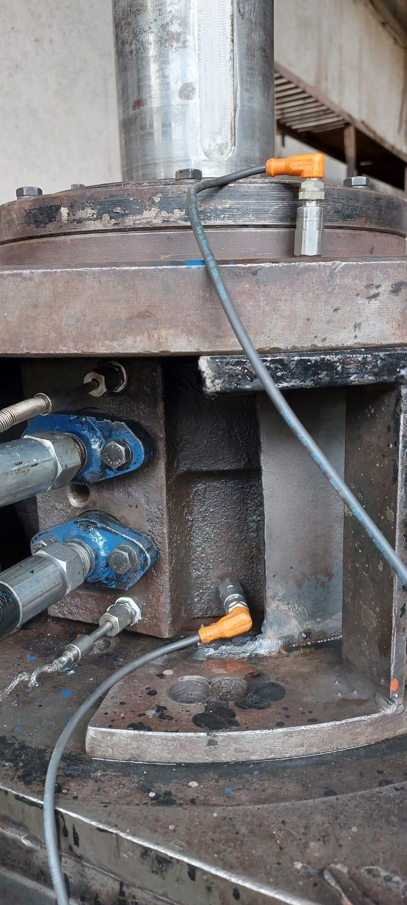
Implementation of Predictive Maintenance

Slide 15
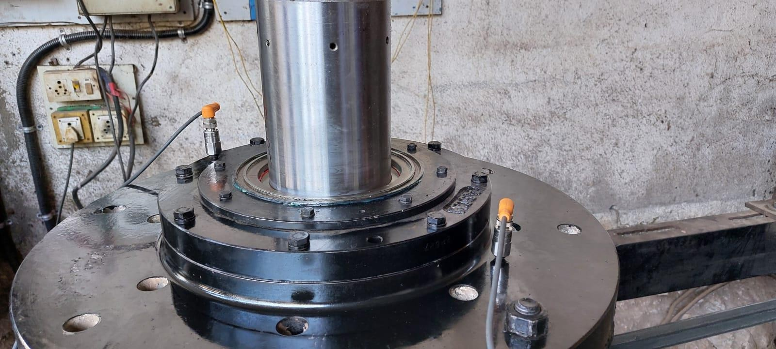
Implementation of Predictive Maintenance

Slide 16

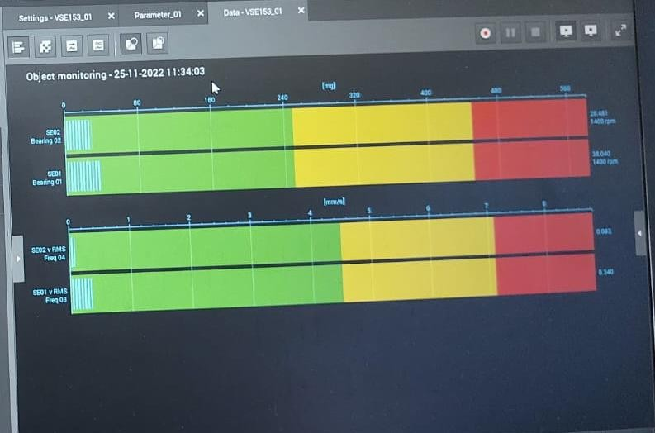
Implementation of Predictive Maintenance
Predictive Maintenance FFT output for health metrics

Slide 17
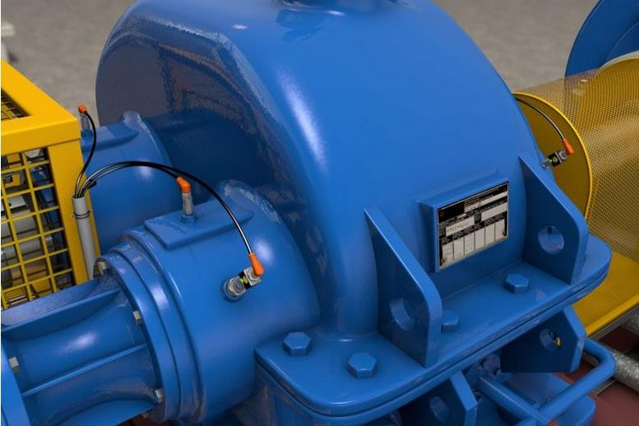
Implementation of Predictive Maintenance

Slide 18
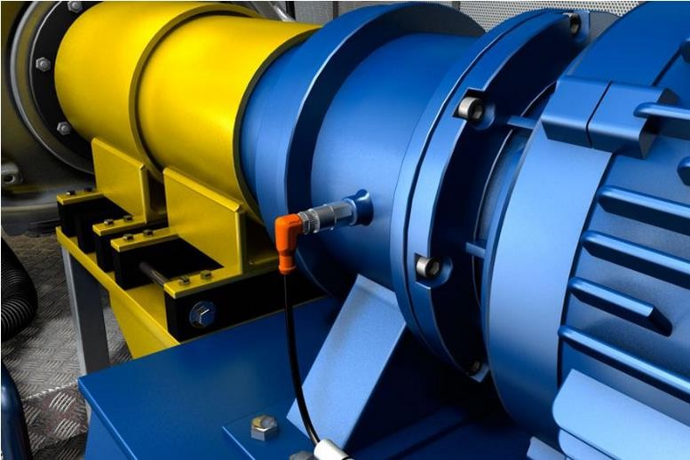
Implementation of Predictive Maintenance

Slide 19
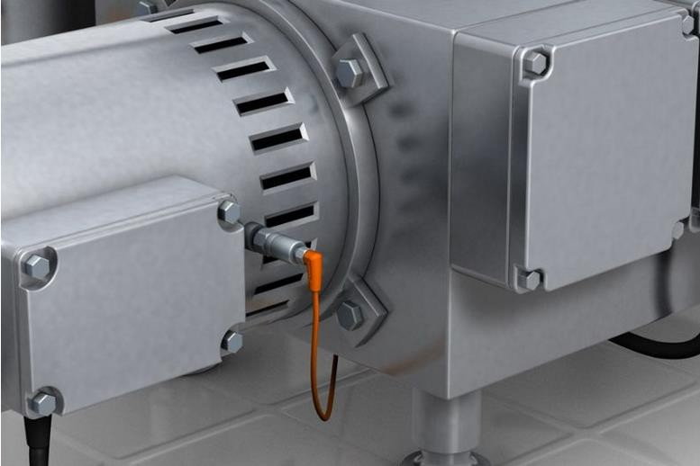
Implementation of Predictive Maintenance

Slide 20
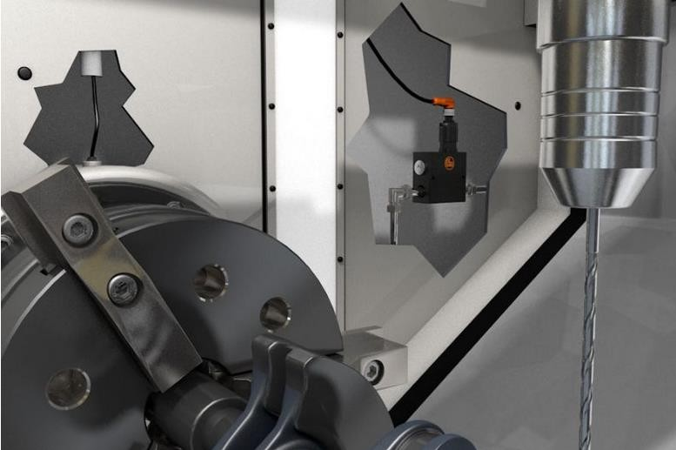
Implementation of Predictive Maintenance

Slide 21
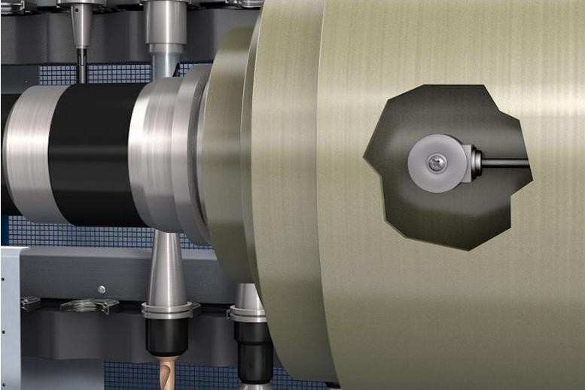
Implementation of Predictive Maintenance

Slide 22
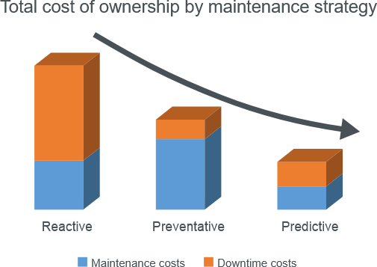
Implementation of Predictive Maintenance

Slide 23

SMART/ SIGMA
Thank You…..

